Slide 1
Resource Allocation for Enhanced QoS in 5G Networks using Advanced Reinforcement Learning and Graph Neural Networks
Team Members:
21I302 Akash K
21I311 Dharunraj A
21I315 Elamurugan RM
21I331 Midhun Ramanujam S
Project Guide
Dr. Anitha Kumari K
Associate Professor
Department of Information Technology
PSG College of Technology
Coimbatore.

Slide 2
Agenda: -
Abstract
Literature Survey
Drawbacks of existing system
Proposed Methodology
Dataset
Block Diagram
Algorithms
Requirements
Timeline
References

Slide 3
Abstract: -
Efficient resource allocation in 5G networks is essential for high-quality service delivery.
Advanced Reinforcement Learning (RL) techniques are applied to optimize bandwidth allocation and reduce latency.
Techniques include Q-Learning, Deep Q-Networks (DQN), Policy Gradient Methods, and Actor-Critic Methods.
States are defined by signal strength, latency, required bandwidth, and allocated bandwidth, with actions adjusting bandwidth based on network conditions.
Integrating RL with Graph Neural Networks (GNNs) enables dynamic, real-time management of network resources.
AI-driven strategies enhance Quality of Service (QoS) and provide valuable insights for data scientists and network engineers.
Optimization is measured by the reduction in the percentage increase from required bandwidth to allocated bandwidth and the reduction in channel latency.

Slide 4
Literature Survey: -
S.No | Title and Authors of the paper | Publication Year and Conference | Inferences | Drawbacks
1. | Reinforcement learning for dynamic resource optimization in 5G radio access network slicing. Shi, Yi, Yalin E. Sagduyu, and Tugba Erpek. | 2020 IEEE 25th international workshop on CAMAD. IEEE, 2020. | The proposed methodology focuses on adjusting the allocated bandwidth to ensure efficient and effective resource utilization. Also maintaining low latency and good signal quality for various applications. | The proposed methodology focuses on single-parameter optimization, specifically on bandwidth allocation, without considering other parameters.
2. | ML-Based Radio Resource Management in 5G and Beyond Networks: A Survey | IEEE Access, vol. 10, pp. 83507-83528, 2022. | The paper highlights ML's effectiveness in throughput prediction and identifies issues like data quality and computational complexity. Offers guidelines for future research to improve ML-based RRM and enhance quality of service (QoS) in 5G/B5G networks. | No significant drawbacks are found in the paper.

Slide 5
Cont’d: -
3. | Effective resource allocation technique to improve QoS in 5G wireless network. Jayaraman, Ramkumar, et al. | Electronics 12.2 (2023): 451. | The proposed methodology offers a significant advancement in resource allocation for CRAN systems by leveraging machine learning techniques to improve prediction accuracy, network throughput, and energy efficiency. It addresses limitations of traditional CSI-based methods and provides a robust solution for managing high-density networks, though further optimization may be needed for extremely high user loads. | The proposed methodology does not provide a dynamic approach that continuously adjusts to evolving network conditions and user demands.
4. | Resource management in 5g mobile networks: Survey and challenges. Chien, Wei-Che, et al. | Journal of Information Processing Systems 16.4 (2020): 896-914. | The study underscores the inadequacy of traditional network approaches for modern applications and emphasizes the need for advanced resource management strategies. Also shows network slicing and MEC are pivotal for future research and development. | No significant drawbacks are found in the paper.

Slide 6
Cont’d: -
5. | A comprehensive survey on radio resource management in 5G HetNets: Current solutions, future trends and open issues. Agarwal, Bharat, et al. | IEEE Communications Surveys & Tutorials 24.4 (2022): 2495-2534. | The paper surveys RRM techniques for 5G HetNets, addressing interference and resource allocation challenges. It categorizes methods into interference management, user association-resource-power allocation, and combined approaches, and outlines future research directions. | No significant drawbacks are found in the paper.
6. | Optimal 5G network slicing using machine learning and deep learning concepts. Abidi, Mustufa Haider, et al. | Computer Standards & Interfaces 76 (2021): 103518. | The paper proposes an efficient 5G network slicing model using a hybrid learning algorithm. It optimizes feature extraction with GS-DHOA and classifies network slices using a hybrid of deep belief networks and neural networks. Improves slicing accuracy and efficiency for diverse 5G applications. | The proposed method lacks adaptability, scalability, and real-time decision-making capabilities. It is not well-suited for complex and dynamic 5G network environments.

Slide 7
Cont’d: -
7. | Reinforcement learning based resource management for network slicing. Kim, Yohan, Sunyong Kim, and Hyuk Lim. | Applied Sciences 9.11(2019) | The paper proposes network slicing in 5G networks to enable creation of virtual networks that are tailored to diverse service requirements. To address the inefficiencies, a dynamic resource management system based on Q-learning is proposed.. Simulations validate the effectiveness in improving the overall network performance in real world scenarios. | Real World performance was not verified
8. | Multi-UAV cooperative task offloading and resource allocation in 5G advanced and beyond. Guo, Hongzhi, et al | IEEE Transactions on Wireless Communications 23.1(2023) | The paper proposes a software-defined networking enhanced cooperative multiple UAV-enabled aerial computing (MUEAC) system. Aims to minimize task processing delays by optimizing task scheduling, resource allocation and data dependencies. A multi-UAV cooperative communication and computing optimization (MCCCO) scheme is proposed. Results validate that MCCCO outperforms traditional schemes. | SDNs and UAVs can be very complex and hard to deploy, also has scalability issues.

Slide 8
Cont’d: -
9. | Handover and load balancing self-optimization models in 5G mobile networks Saad, Wasan Kadhim, et al. | EngineeringScience and Technology, an International Journal.(2023) | The paper discusses a QoS-based resource allocation scheme using OFDM-based interface for device to device (D2D) within cellular networks, allowing flexible allocation of the resources. The results of the paper validate the effectiveness of the proposed methodology while also accommodating service flexibility. | Scalability remains a problem, as the number scaling QoS poses a significant challenge.
10. | Smart load-based resource optimization model to enhance the performance of device-to-device communication in 5G-WPAN. Logeshwaran, Jaganathan, et al | Journal: Electronics 12.8 Year: 2023 | The paper discusses various optimization techniques for device-to-device (D2D) communication in wireless networks. Focuses on resource allocation strategies including dynamic allocation of bandwidth and resources and load balancing. The proposed load based resource optimization model is shown to achieve 86% network efficiency and 91.94% reduced latency. | While the tests are done via simulation, the results are yet to be validated in real world scenarios.

Slide 9
Drawbacks of existing system: -
Single parameter optimization: The existing system optimizes only one parameter.
Scalability concerns: They are not efficient for complex and dynamic environment.
No actions are taken based on previous state information.
Low Adaptability: They are less adaptable in dynamic approach that continuously adjusts to evolving network conditions and user demands.

Slide 10
Proposed Methodology: -
This project leverages reinforcement learning (RL) and Graph Neural Networks (GNNs) to dynamically manage network resources such as bandwidth and latency.
The proposed system aims to optimize resource allocation based on key network parameters.
RL framework represent the state of the system is represented by a combination of application type, signal strength, latency, required bandwidth, allocated bandwidth and resource allocation.
Actions involve adjusting the allocated bandwidth for each user and optimizing latency by modifying signal strength.

Slide 11
Contd’: -
The reward function is designed to reflect the efficiency and effectiveness of resource allocation, favoring scenarios where allocated bandwidth meets or slightly exceeds required bandwidth while maintaining low latency and good signal strength.
The approach evaluates several RL algorithms, including Q-Learning, DDGP Methods. The agent is trained over multiple episodes, interacting with the environment to learn and improve its policy based on cumulative rewards.
The Graph Neural Network is integrated to to capture spatial and temporal dependencies in the network ,enhancing the learning process and resource allocation decisions.

Slide 12
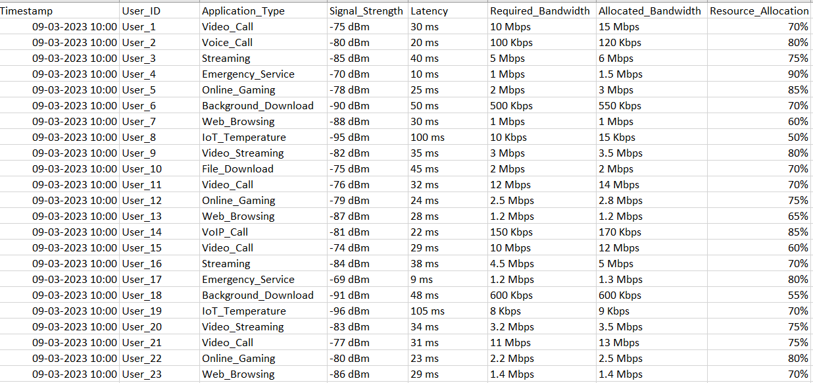
Dataset
FEATURES :
Signal strength: -90 dBm (weak) to -30 dBm (strong)
Application Type: The type of application.
Latency: 0 ms (ideal) to 100 ms (realtime: 20 ms to 30 ms)
Req bw: varies by application (eg: 5-10 Mbps - HD video streaming, 3-6 Mbps - Online Gaming, 1-5 Mbps - General Web Browsing)
Allocated bw: exact or slightly exceed bw allocation, not lesser or over-provisioning.
Resource Allocation: Efficiency of allocated resource.

Slide 13
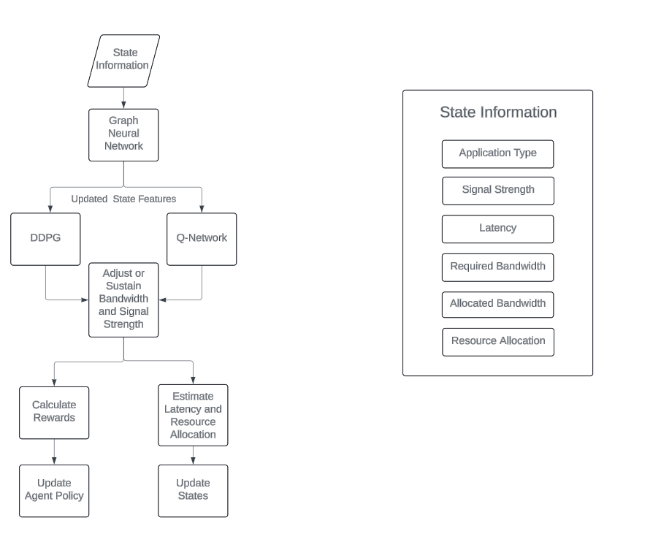
Block diagram: -

Slide 14
Algorithm
Preprocess the dataset and discretize the features.
Train the GNN model using the discretized dataset.
Train the reinforcement learning models with the states derived from the GNN model.
Predict actions (sustain, increase, decrease allocated bandwidth or signal strength) and update states in each iteration.
Calculate rewards and update the agent policy in each iteration.6. Evaluate model performance based on resource allocation and perform fine-tuning.

Slide 15
Environment(GNN)
Network Topology:
A GNN is well-suited for capturing the dependencies and relationships between nodes and accurate modelling for the DL algorithms.
Nodes: Represent entities in the network (e.g., devices, base stations).
Edges: Represent connections or interactions between nodes (e.g., signal Strength, bandwidth allocations).
Feature Representation:
To capture important features such as signal Strength, Bandwidth and Latency ,Application Type .
Dynamic Adaptation:
GNNs has the ability to adapt to changes in the network topology. As the network evolves , the GNN can dynamically update its representations to reflect the current state of the network.
crucial for real-time resource allocation in a 5G network, where conditions can change rapidly.

Slide 16
Requirements
Hardware Requirements
Processor: Intel i5 series
RAM: 8 GB
GPU: 4 GB
Software Requirements
Operating System: Windows 10, MacOS
Coding Language: Python, JavaScript
Packages: Keras, Torch, Matplotlib, TensorFlow, Random, Pandas, Scikit-learn, NumPy
IDE: Google Colaboratory, Visual Studio Code

Slide 17
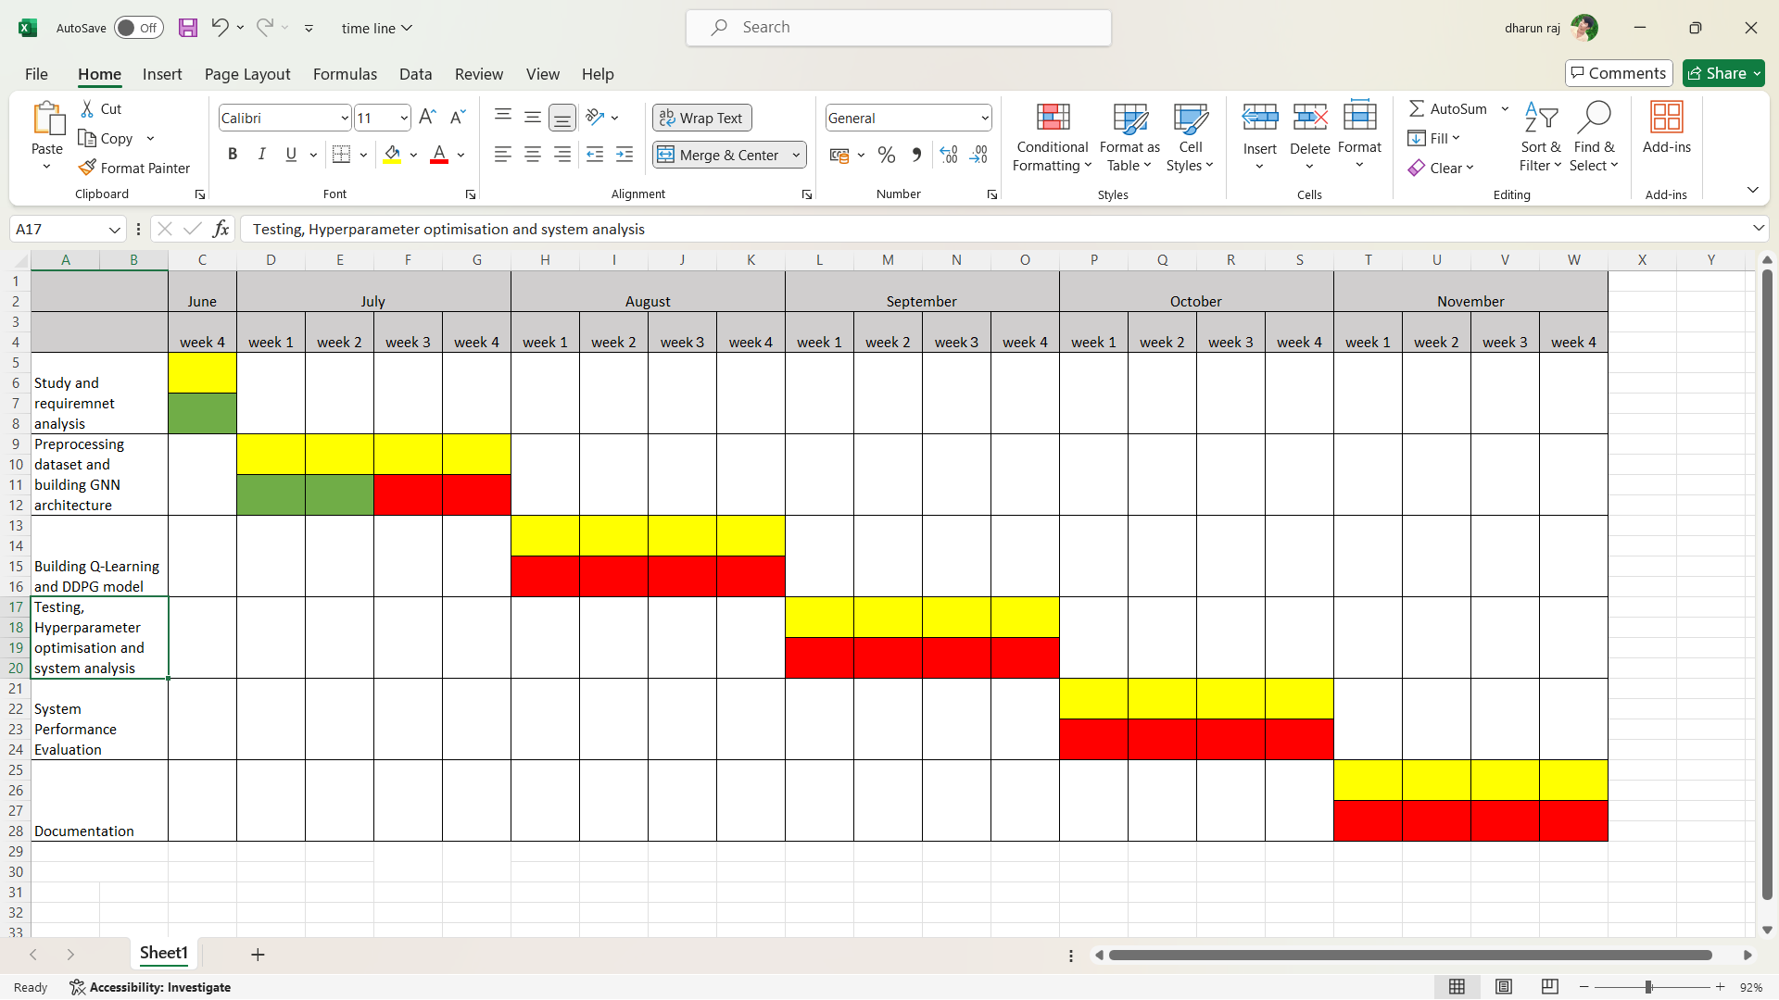
Timeline chart: -
Work in progress
Works Assigned
Works to be done

Slide 18
References: -
Shi, Yi, Yalin E. Sagduyu, and Tugba Erpek. "Reinforcement learning for dynamic resource optimization in 5G radio access network slicing." 2020 IEEE 25th international workshop on computer aided modeling and design of communication links and networks (CAMAD). IEEE, 2020.
Jayaraman, Ramkumar, et al. "Effective resource allocation technique to improve QoS in 5G wireless network." Electronics 12.2 (2023): 451.
Chien, Wei-Che, et al. "Resource management in 5g mobile networks: Survey and challenges." Journal of Information Processing Systems 16.4 (2020): 896-914.
Agarwal, Bharat, et al. "A comprehensive survey on radio resource management in 5G HetNets: Current solutions, future trends and open issues." IEEE Communications Surveys & Tutorials 24.4 (2022): 2495-2534.
Abidi, Mustufa Haider, et al. Optimal 5G network slicing using machine learning and deep learning concepts. Computer Standards & Interfaces 76 (2021): 103518.

Slide 19
References: -
ΜΠΑΡΤΣΙΩΚΑΣ, Ιωάννης. ML-Based Radio Resource Management in 5G and Beyond Networks: A Survey (2023).
Kim, Yohan, Sunyong Kim, and Hyuk Lim.“Reinforcement learning based resource management for network slicing”. Applied Sciences 9.11(2019).
Guo, Hongzhi, et al. Multi-UAV cooperative task offloading and resource allocation in 5G advanced and beyond. IEEE Transactions on Wireless Communications 23.1(2023).
Saad, Wasan Kadhim, et al. “Handover and load balancing self-optimization models in 5G mobile networks”. EngineeringScience and Technology, an International Journal.(2023)
Logeshwaran, Jaganathan, et al. “Smart load-based resource optimization model to enhance the performance of device-to-device communication in 5G-WPAN”. Electronics 12.8 (2023)

Slide 20
THANK YOU!

